Slide 1
Attacking Active Directory 101
An small introduction into Attacking Active Directory

Slide 2
Whoami
Name-Daniel Little
Role: Senior Penetration tester @ Claranet Cyber Security
Experience: 7 years in Offensive Cyber Security
Advocate for home lab and self hosting
Data hoarder
Sysadmin Cosplayer

Slide 3
Disclaimer
There is a lot to Active Directory it is a topic I can not cover in just half an hour.
I am no expert on AD I just enjoy it.
I would like to make this talk into a semi series if you all enjoy!
I often talk a bit to fast please shout up if I need to slow down, we have a lot to cover today!

Slide 4
What will be covered today
A brief talk about what is Windows Active directory
Active directories main components
What do we look for when attacking Active Directory
Tools used to enumerate Active Directory
Tools used to attack Active Directory
Common Quick Wins and Common Misconfigurations
What can Blue teams do to make are lives harder?

Slide 5
What will not be covered in this talk
Hybrid AD (Mostly focusing on internal networks setups)
Red teaming within Active directory
Multi Domain attacks.
Deep diving multi chained attacks.
I advise you all do you own research use this talk as a jumping off point !

Slide 6
So What is Actie directory
We have all used it (even if we are not a fan of it)
Released in 1990 with Windows Server 2000 Server edition.
It's a directory service developed by Microsoft for Windows domain networks, serving as an essential tool for organizing and managing users, their attributes and group membership, computer accounts, network resources.
It offers multiple network services as well such as DHCP DNS SMTP and user authentication.

Slide 7
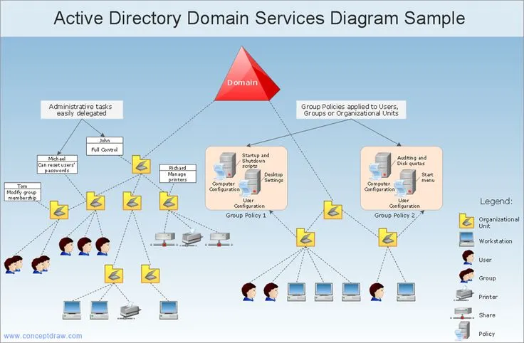
Overview of an Active directory network.

Slide 8
Types of users and accounts
User account: Standard user account found within Active directory. Set up by Domain Admin Accounts.
Local Administrator: An account that sits within the local group and can not be locked.
Service Accounts: A service account is a user account that's created explicitly to provide a security context for services that are running on Windows Server. An Example of this would be a database account. Has a Service Principal Name.
Guest Accounts: low-privilege Windows account that exists on every Windows system. It's available to users that don't have an account defined and need occasional access to a Windows system.

Slide 9
What is the “Domain” inside an active directory
This is the main “name” if you will of the organisation
A Domain is a single tree
However, some organisations can have multiple domains often called forests (Little out of scope for this talk maybe in 102?)
Often seen as name/domain for example – D.little@domain or domain/D.little

Slide 10
Technologies Found within AD
Windows Server (2016-2025)
Windows 10-11 Pro and Enterprise
SMB (Port 445)
LDAP (Port 389)
Kerberos (Port 88)
Net Bios (Port 137-139)
RPC (Dynamic range from 49152-65535)

Slide 11
Windows Servers
These often make a good chunk of hosts found within AD environments
While Windows Server 2016 is supported any server version can be found floating about the network
Windows NT Server 3.x.
Windows NT Server 4.0.
Windows 2000 Server.
Windows Server 2003.
Windows Server 2008 and 2008 R2.
Windows Server 2012 and 2012 R2.
-- Still supported
Windows Server 2016, 2019 and 2022.
Windows Server 2025.

Slide 12
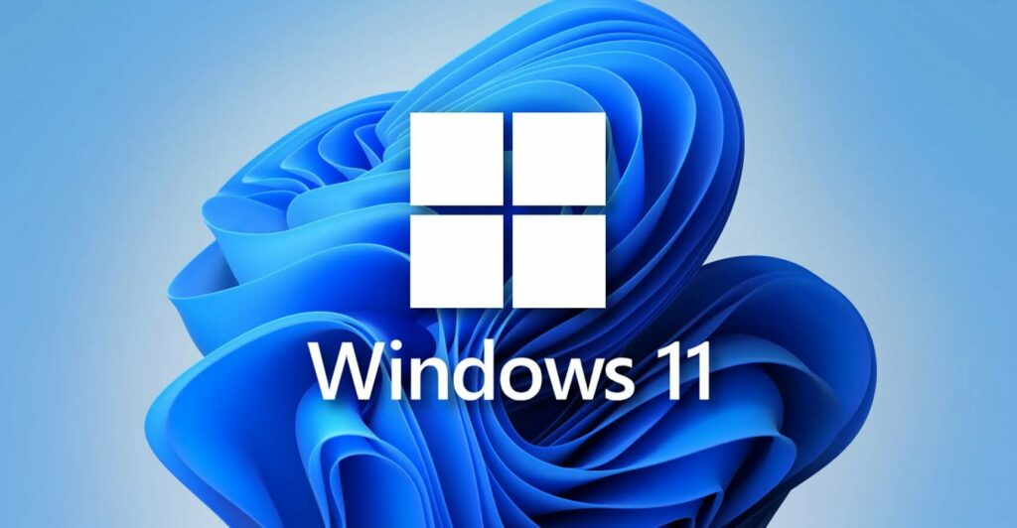
Windows Hosts
Windows 10 support is ending!!
Windows 11 should be all you start seeing within AD moving forward but we know what business are like!
We still see Windows XP floating about.

Slide 13
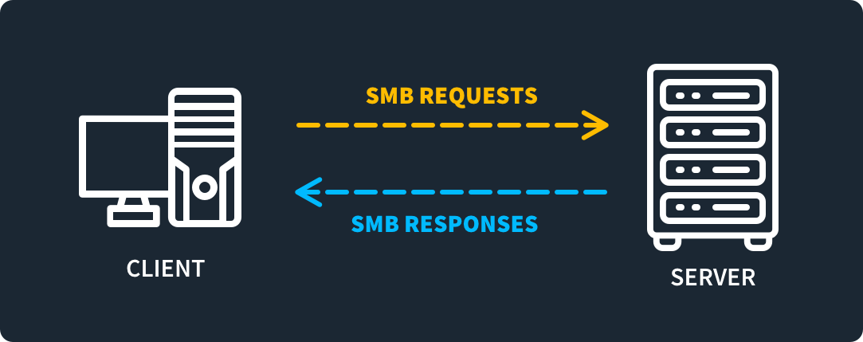
SMB Port 445
Server messaging block mainly used as a communication protocol to share files printers and other network communication.
A very handy port to help identify operating system versions within AD. (More on this soon)
Misconfigurations include no signing and null sessions and relay attacks

Slide 14
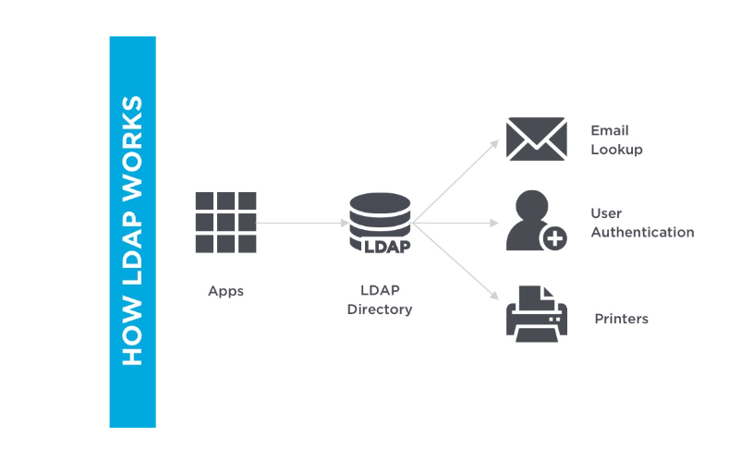
LDAP (Port 389) Lightweight Active directory Protocol
Ldap is used to maintain and access directory services within AD. It keeps a database of all members and group polices and other servers and services within the network such as printers.
Can be a great place to enumerate users from.
Commonly misconfigured to provide more information than it should.
By default, uses unencrypted communications.
Recommended to run TLS over the top of it to prevent this. Also please enable LDAP Signing

Slide 15
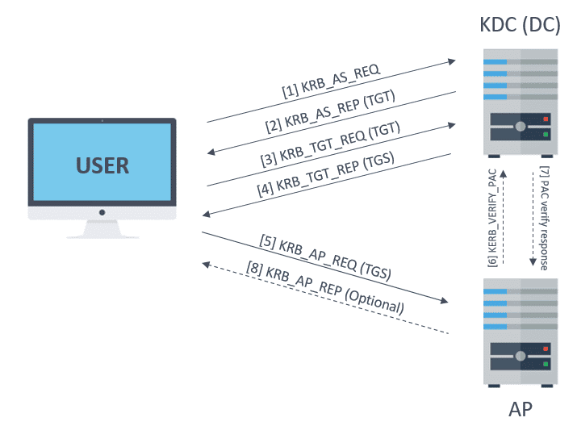
Kerberos (Port 88)
A key component of AD Authentication
Works of a ticket based system for users to prove who they are.
Currently the standard for authentication security within AD.
Replaces NTLM and NTLMV2 authentication though if this fails NTLMV2 will be used.
Authentication through the local KDC uses AES out of the box improving the security of local authentication.
Can still be attacked though (More on that in the next talk)

Slide 16
Net Bios (Port 137-139)
NetBIOS (Network Basic Input/Output System) is a network service that enables applications on different computers to communicate with each other across a local area network (LAN).
Not many vulnerabilities affecting Net Bios these days. It is a good way to gain valuable information within AD such as domain name and system naming scheme.
nbtscan nmap and nmblookup are great tools to enumerate NetBios.

Slide 17
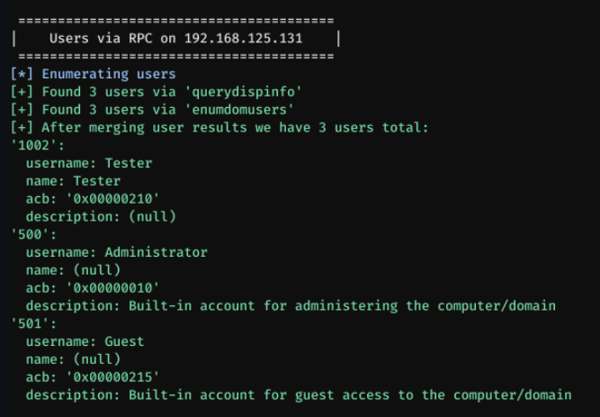
RPC Port 135
Remote Procedure Call is a communication protocol that allows a program to execute a procedure (function) on a remote server as if it were a local function.
Typically runs on port 135 and 593 but can run on other higher end ports
Enumerating this port can be done with Nmap scripting engine
Nmap -p 135,593 --script=msrpc-enum <TARGET_IP>
Enum4linux-ng –A <TARGET_IP>

Slide 18
Types of password hashes found in ad
NTLM Hash (NT Hash) Also known as the NT hash, this is the most common hash used in AD. (Stored in SAM Database) No salt, making it vulnerable to offline brute-force attacks. NTLMV2 is an improvement can no longer do pass the hash with them but can still be cracked offline.
LM Hash (LAN Manager Hash) Older and weaker Hash no longer used. Super easy to crack and can be passed.
Kerberos Hashes used in Kerberos authentication this is the default authentication in current Local AD. This type of hash can be still taken offline and cracked but cant be passed.

Slide 19
Tools used to enumerate and attack AD
Nmap
Enum4linux-NG
Impacket
Nxc (Formally crackmapexec)
Bloodhound (requires a foothold)
Responder
Hashcat

Slide 20
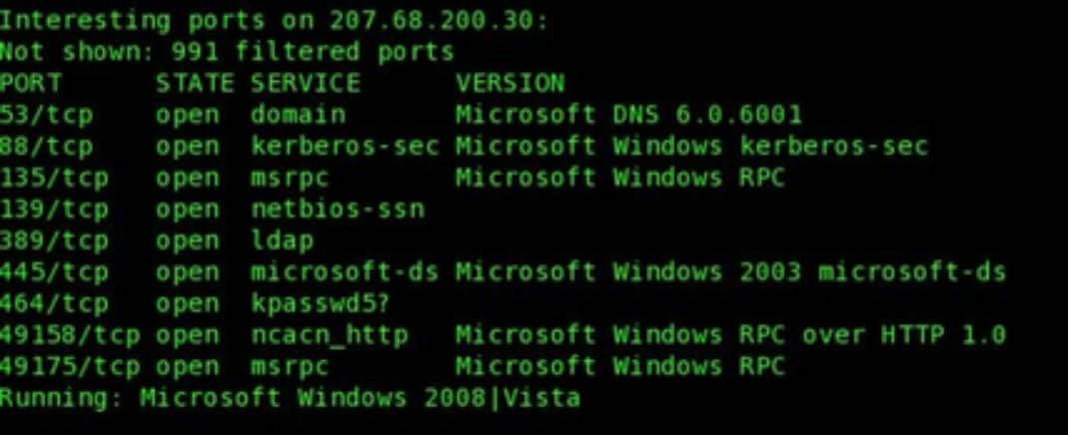
Nmap
The best port scanner around (In my view)
Great for scanning networks quickly or slowly helps map out the network.
SMB enumeration scripts built in along side other helpful scripts.
Other NSE scripts for enumerating other ports such as RPC Netbios and Web ports (IIS Anyone?)

Slide 21
Enum4linux-NG
Great tool for enumerating Windows/Samba systems.
Can make use of SMB Null session to pull information out.
Enumerating RPC as well.
Great tool for enumerating users within a Windows AD joined machine.
Even more powerful with captured credentials.

Slide 22
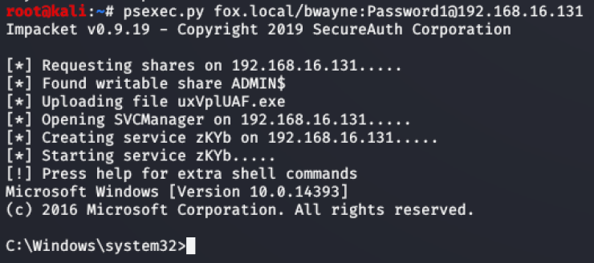
Impacket
Impacket is a versatile Python-based toolkit used within penetration testing and red teaming.
Its Example library is extensive and can aid in many attacks against Windows Active Directory.
Most notable ones I find myself using
psexec.py – Ofters psexce like functionality
GetUserSPNs.py Great way to fetch Service Principle names that are associated with normal user accounts.
There are so many more that this tool can be a talk all on its own.

Slide 23
Nxc
Possibly my most favourite tool has gotten me from no user to DA many times.
Great tool and works with many different network protocols.
Can perform password spraying NTS.DIT file extraction remotely.
Can execute remote commands on a Windows system with valid creds.
Becomes even more powerful with working credentials.
Example Command- nxc smb 192.168.1.101 -u user.txt -p password.txt

Slide 24
Bloodhound
BloodHound is an open-source Active Directory (AD) analysis tool used by both penetration testers and attackers to map out privileges, relationships, and attack paths within an AD environment.
This tool is more used once a foothold has been established. It is super noisy so more suited to a pentest than a redteam engagement.

Slide 25
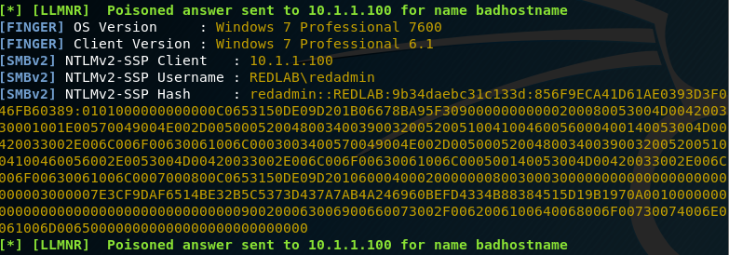
Responder
Responder is an open-source LLMNR, NBT-NS, and MDNS poisoner used to perform network-based attacks in Windows environments.
Windows uses LLMNR (Link-Local Multicast Name Resolution) and NBT-NS (NetBIOS Name Service) for name resolution when DNS fails.Responder exploits these protocols by intercepting authentication requests, tricking victims into sending their NTLMv1/NTLMv2 hashes.

Slide 26
HASHCAT
My faviourte password cracker.
Hashcat is a great tool for cracking those hashes captured by responder or found when performing a NTS.dit extraction or other types of AD Attacks.
Recommend a strong GPU 60 range or higher unless you have a lot of time.
Rock you.txt Rocktastic are good lists to start with.
https://github.com/NotSoSecure/password_cracking_rules - Great rule to include as well.

Slide 27
Quick easy Wins
SMB Null Sessions- Great place to start enumeration
Look for out of date Windows Servers/Hosts maybe a quick RCE CVE?
Look for weak passwords
OSINT gather usernames- Linkedin sharepoint job ads.
LLMNR Poisoning
As-Rep roasting (more on this next talk)
Kerbroasting (more on this next talk)

Slide 28
What can blue teams do?
Ensure SMB signing is enabled
Turn off LLMNR in GPO
Ensure strong password policy
More to come in next talk !

